Slide 1


Community Services
Child Care

Slide 2












COMMUNITY SERVICES

Slide 3
COMMUNITY SERVICES
Programs
  211
  ADRC
  Family Caregivers Alliance
  After Hours Protective Services
  Benefits Enrollment Center
  SNAP Outreach
  Medicare & Medicaid Enrollment
  HealthSource Navigator
Services
  Call Center Services
  Off site Office Hours
  Walk-in Center
  Information & Application Assistance
    Medicare
    Medicaid
    Long Term Services
    Home care
    Caregiver support
    Child Care

Slide 4
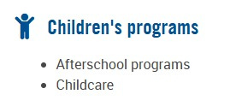
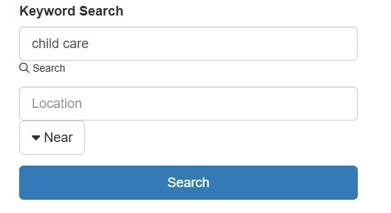

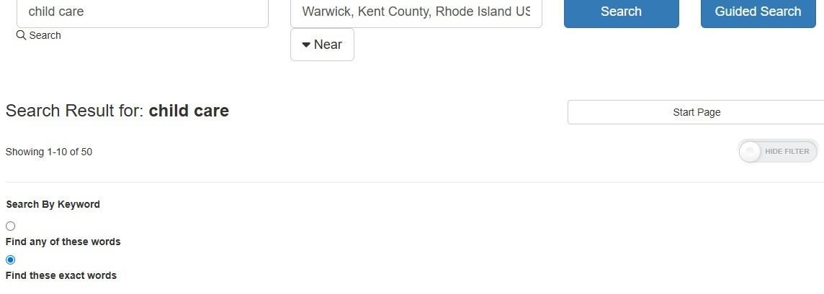
211 RESOURCES
https://www.unitedwayri.org/get-help/2-1-1/
  211 Assists with Child Care Resources & Applications
  Research the Website, Chat or Call for Resources
  Dial 211 or 1-800-367-2700

Slide 5


CHOOSING CHILD CARE
Partner: http://www.brightstars.org/
https://earlylearningprograms.dhs.ri.gov/s/?language=en_US
Help Find Child Care to fit Specific Needs
Phone at (401) 739-6100 or 1-855-398-7605 or by email at info@BrightStars.org. Services are available in both English and Spanish.
https://dhs.ri.gov/programs-and-services/child-care/child-care-assistance-program- ccap/choosing-child-care

Slide 6
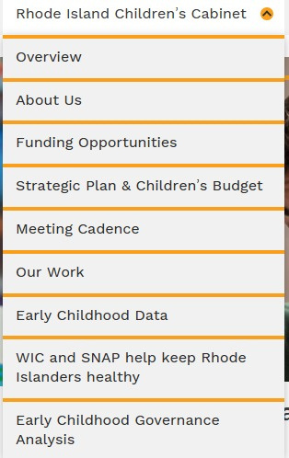

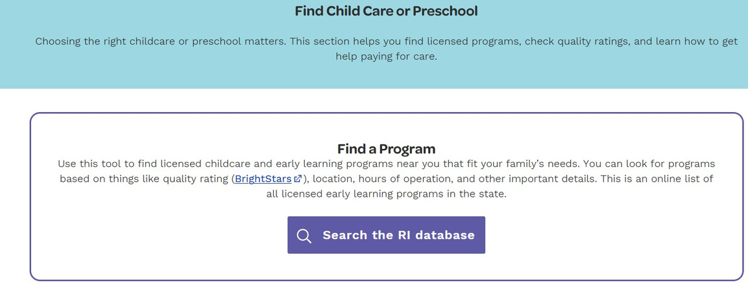
RHODE CHILDREN’S CABINET
https://kids.ri.gov/
https://kids.ri.gov/rhode-island-childrens-cabinet/our-work
https://kids.ri.gov/prenatal-pre-k-resources/find-child-care-or-preschool

Slide 7

CHILD CARE PROGRAM & SERVICES
  Child Care Licensing
  Child Care Assistance Program
  Head Start Collaboration Office
  Quality Initiatives& Contracting
  Rhode Island Start Early System (RISES)
https://dhs.ri.gov/programs-and-services/childcare

Slide 8

FOR CHILD CARE PROVIDERS
Resources for Providers
Opening a Child Care in RI
Background Checks
Child Care Resources, Forms, and Handbooks
Provider Support
Market Rate Survey
Quality Initiatives Workforce Development State Plans Children's Cabinet
https://dhs.ri.gov/programs-and-services/child-care/child-care-providers-staff-resources

Slide 9
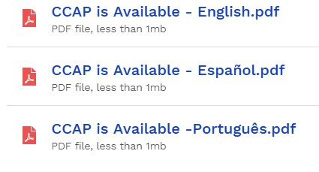

CHILD CARE ASSISTANCE PROGRAM -CCAP
Child Care Assistance Program Subsidize cost of child care For children who are US citizens, legal residents under 13 or 18 (special needs cases)
Family Eligibility & How to Apply
CCAP Provider Rates, Financial Information & Portal Help
Choosing Child Care
Family Resources
Overpayments Appeals
https://dhs.ri.gov/programs-and-services/child-care/child-care-assistance-program-ccap

Slide 10
CHILD CARE ASSISTANCE PROGRAM -CCAP
Income eligible families who meet guidelines and are working a minimum of
20 hours per week at or above Rhode Island's minimum wage.
Families participating in training, apprenticeship, internship, on-the-job training, work experience, work immersion sponsored by the Governor’s Workforce Board, who need child care in order to take part in these job readiness/training opportunities.
Families enrolled in a degree program at a Rhode Island public institution of higher education: Community College of Rhode Island (CCRI), Rhode Island College (RIC), or the University of Rhode Island (URI) who need child care in order to maintain enrollment in the degree program.
Families participating in theRhode Island Works program.
Pregnant/Parenting Teens participating in DHS’s Teen and Family Development (TFD) program.
https://dhs.ri.gov/programs-and-services/child-care/child-care-assistance-program-ccap

Slide 11

CHILD CARE ASSISTANCE PROGRAM -CCAP
Head Start – with or without CCAP
Head Start Eligibility & How Do I Apply?
Head Start Collaboration Office
Head Start Locator Tool
RI Head Start Association
https://dhs.ri.gov/programs-and-services/child-care/child-care-assistance-program-ccap

Slide 12


211 - COMMUNITY HELPLINE
  Recently accredited by Inform USA
  Free, confidential, available 24/7 in 200+ languages Phone, text, web chat, guest services drop-in at 50 Valley Street, and mobile outreach RV
  RI 211 - highest volume per capita in the country (145,000 calls and contacts in 2023, 213,000 in 2024)
  Top needs include housing, utility assistance, healthcare, income support, and food assistance
  On average, our staff identifies 4 needs per caller

Slide 13


AGING AND DISABILITY RESOURCE CENTER
ADRCis funded by the Rhod eIsland Office of Healthy Aging with a grant from the Administration from Community Living
  Serves seniors, and adults with disabilities, and caregivers in Rhode Island
  MyOptions RI web services with Executive Office of Health and Human Services
  Information and enrollment services for SNAP
  No Wrong Door Service Delivery
31

Slide 14
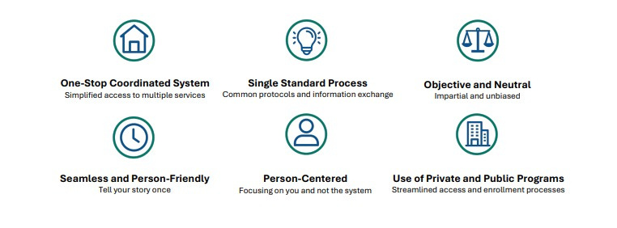
NO WRONG DOOR
  No Wrong Door helps people find trustworthy information about long-term care and services they can receive at home or in their community
  No matter their age, disability, how much money they have
  NWD Helps people
    Learn about their support options
    Make informed choices about their care
    Have more control over how their needs are met
    Work towards personal goals
31

Slide 15




SPECIALIZED SERVICES
Accessto care navigators & specialists
Public access to local health, human and community services
Secure sharing of information with partners
Follow-up
Electronic referrals real time communication – MyOptions RI
Coordination between healthcare & human service providers

Slide 16
Volunteer Income Tax Assistance (VITA)
Visit any Volunteer Income Tax Assistance (VITA) site for service.
For information about site locations and times, please dial 2-1-1.
Volunteer preparers are trained and certified by the IRS.
E-filing for fast returns.
Get your Earned Income Tax Credit (EITC) and Child Tax Credit.
may qualify for an EITC credit of up to $8,046
Who is Eligible?
Single, head of household, earning less than:
$19,104 – no qualifying children
$50,434– one qualifying child
$57,310– two qualifying children
$61,555– three or more qualifying children
Married, filing jointly, earning less than:
$26,214– no qualifying children
$57,554 – one qualifying child
$64,430– two qualifying children
$68,675– three or more qualifying children

Slide 17
VITA What is Needed
Social Security Card
Original Social Security Card(s) for self, spouse, and all dependents
Picture ID
Valid Picture ID for self and spouse (if applicable)
Tax forms
All 2025 W-2, 1099 and 1095-A forms
Tax Return
Copy of 2024 Federal Tax Return if you have it
Child and dependent care expense
Tax Identification Number (SSN, EIN) of the care provider
For direct deposit
A check or a savings account number with routing number
For Property Tax Relief
For Property Tax Relief – only for disabled receiving Social Security or 65 and older, bring three 2025 rent receipts, full name, phone number and address of landlord, all household income, SS Statement (Form SSA-1099) or award letter
Proof of Health Insurance
Healthsource RI paperwork or proof for all health insurance coverage

Slide 18
CONTACT US!
Contact us at: 401-462-4444 (main number)
Dial 211 or 1-800-367-2700
For ADRC – 401-462-4444
For After Hours Protective Services – 401-462-0555
For Gambler Helpline – 1-877-9
Gamble For My Options Web Intakes - https://myoptions.ri.gov/
To Chat https://www.unitedwayri.org/get-help/2-1-1/
Location: 50 Valley St Providence, RI 02908
Cristina Amedeo
Email: cristina.amedeo@unitedwayri.org
Cell: 401-263-4545 (please text the first time you reach out)

Slide 19


